Slide 1

SSIS 2012: The Quiet Revolution
Presented by Bryan Cafferky
Business Intelligence Consultant
bryan256@msn.com
www.sql-fy.com
www.linkedin.com/in/bryancafferky
The RI Business Microsoft Intelligence User Group
http://www.meetup.com/The-RI-Microsoft-BIUG/

Slide 2
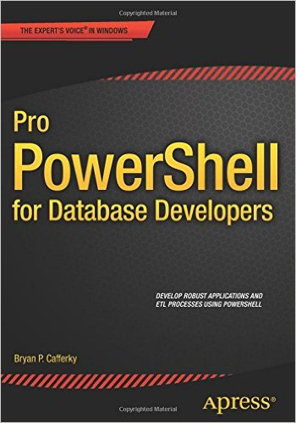
Author: Pro PowerShell for Database Developers

Slide 3
Parallel Paths
Whimsical MEMEs
Topic Matter

Slide 4
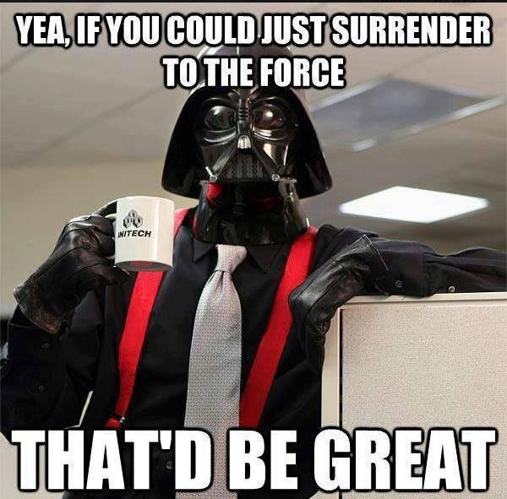

Slide 5
SSIS 2012
What is the Quiet Revolution?
Improved configurability.
Better transparency/visibility.
Improved deployment process.
True database service execution.

Slide 6
SSIS 2012
Architectural Details
New Architecture Addresses Many SSIS Limitations!
New SSIS Catalog in SQL Server managed via SSMS.
Built-in SSRS Reports on package executions.
Project Deployment Model: All the packages in the project are deployed together.
Configurable Project and Package parameters.
Environments – containers of configurations settings.
True database service execution.

Slide 7
SSIS 2012
Configuration Improvements
Project Deployment Model
All the packages in the project are deployed together.
Packages in the project can share Parameters and Connection Managers.
Parameter and Configuration Values can easily be configured in SSMS.
The Legacy Package Deployment Model is available but does not support the above features.

Slide 8
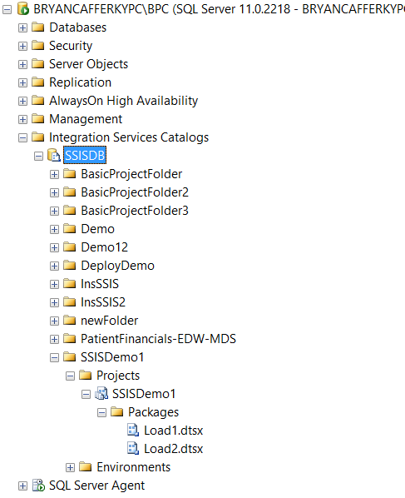
SSIS 2012
Drum roll……The ssis catalog!

Slide 9
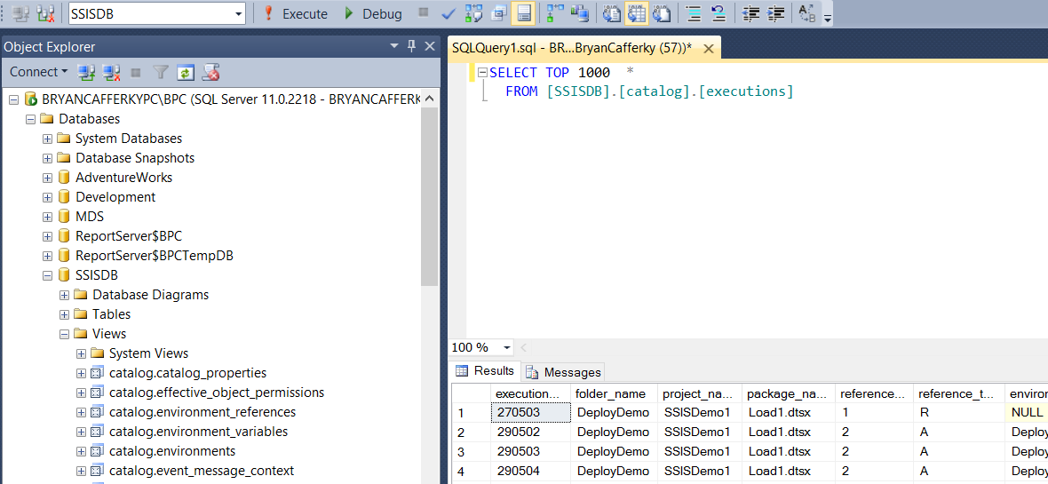
SSIS 2012
Ssis catalog views – The dba’s dream come true

Slide 10
SSIS 2012
A Simple project example

Slide 11

SSIS 2012

Slide 12
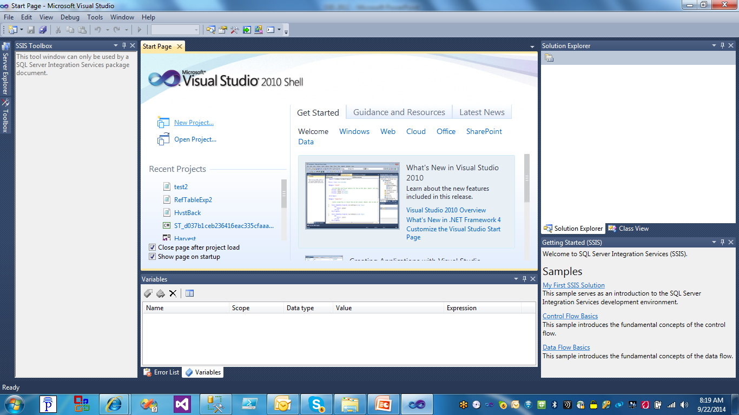
SSIS 2012
Creating a Project
Click on New Project

Slide 13
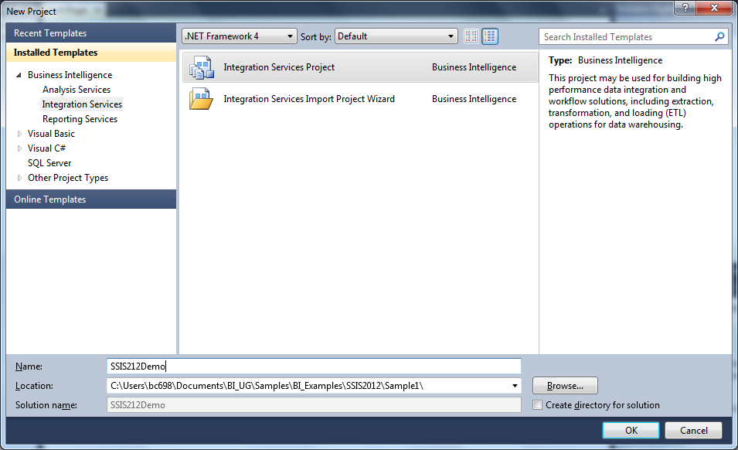
SSIS 2012
Creating a Project
Click on Integration Services Project

Slide 14
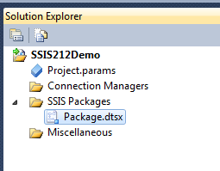
SSIS 2012
Creating a Project – Project Level Configuration
New in 2012 – Project Parameters
And
Project Level Connection Managers

Slide 15
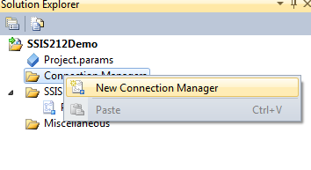
SSIS 2012
Creating a Project – Project Level Configuration
Right Mouse Click and Select New Connection Manager to create a Project Level Connection Manager

Slide 16
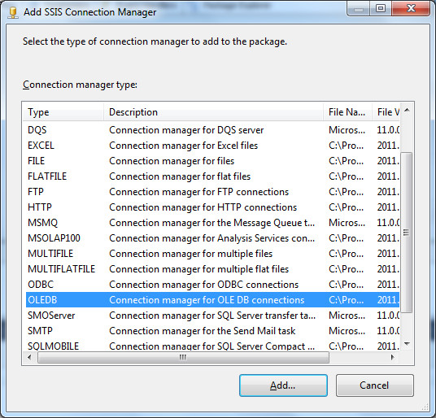
SSIS 2012
Creating a Project – Project Level Configuration
Select the Connection Type. OLEDB is the most common, i.e. SQL Server.

Slide 17
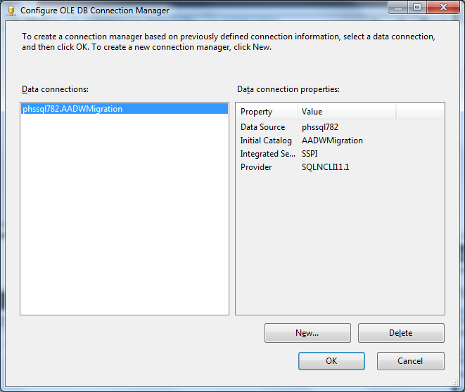
SSIS 2012
Creating a Project – Project Connection Manager
Enter the Connection Properties.

Slide 18
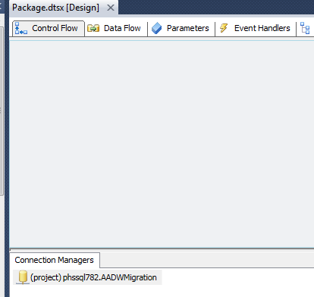
SSIS 2012
Creating a Project – Project Connection Manager
Note: (project) indicates this is a Project Level Connection Manager.

Slide 19
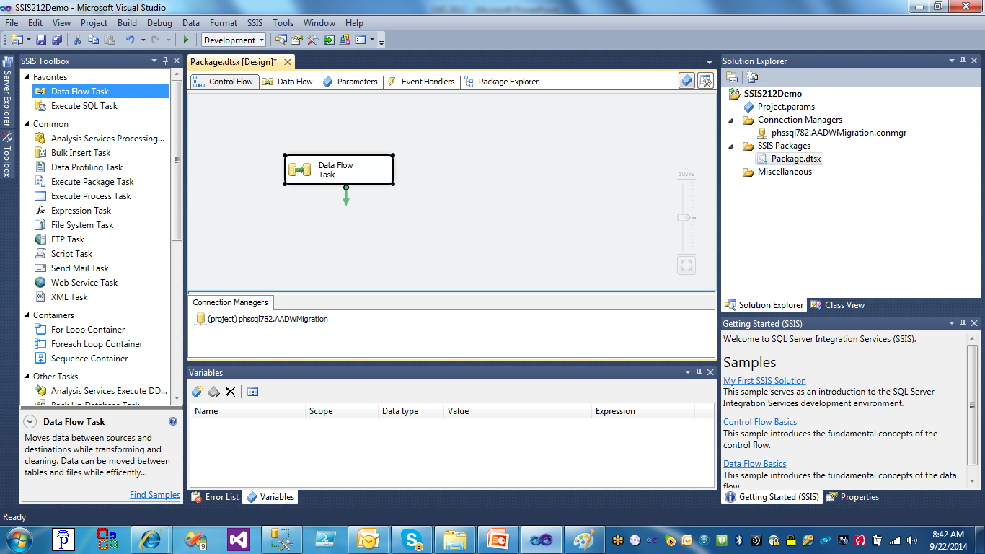
SSIS 2012
Add a Data Flow.
Creating a Project – Project Connection Manager

Slide 20

SSIS 2012

Slide 21
SSIS 2012
Parameters:
Variables that can be configured externally.
Can be scoped to the package or project.
Variables can get their value from a parameter.

Slide 22
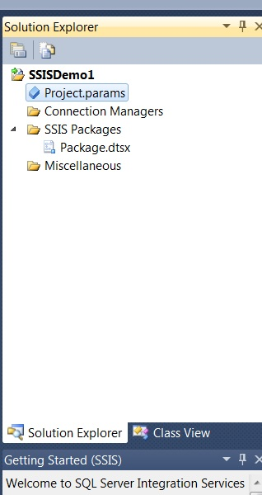
SSIS 2012
Creating a Project – Project Parameter
Double Click on the Project.parameters to create Project Parameters.
Project Parameters are just Project Level scoped variables but they are exposed
To the Configuration Editor in SSMS and SQL Agent.

Slide 23
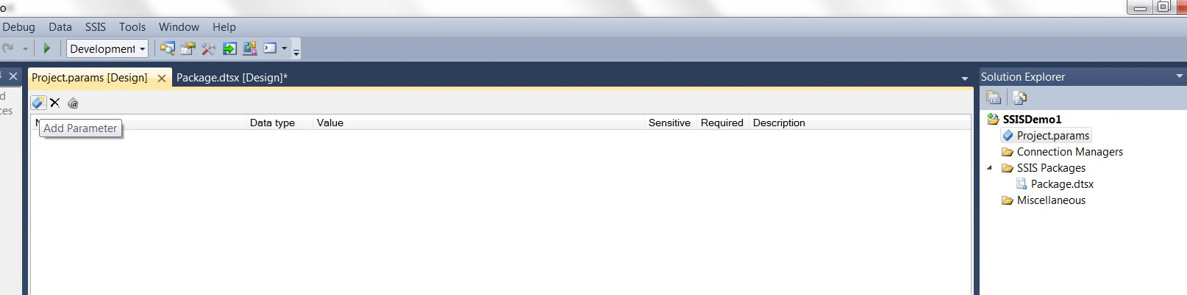
SSIS 2012
Creating a Project – Project Parameter
Click on the Add Parameter Icon

Slide 24
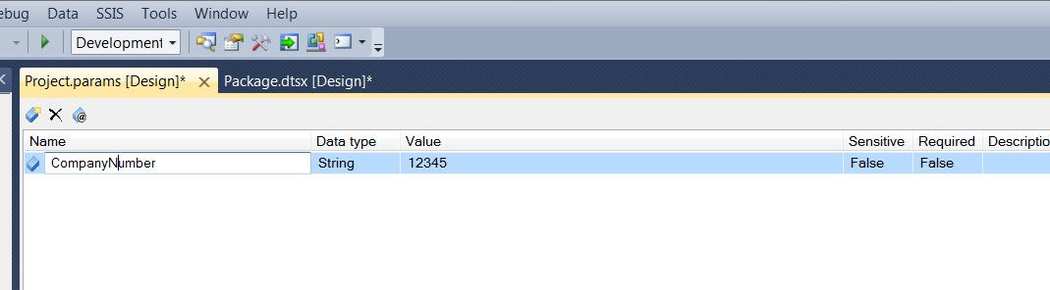
SSIS 2012
Creating a Project – Project Parameter
Enter Parameter Details

Slide 25
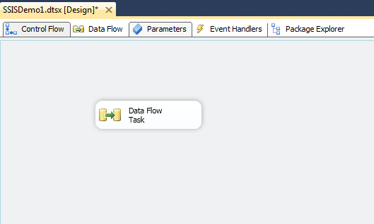
SSIS 2012
Creating a Project – package Parameter
With a package open, click on the Parameters tab so we can create Project Parameters.

Slide 26
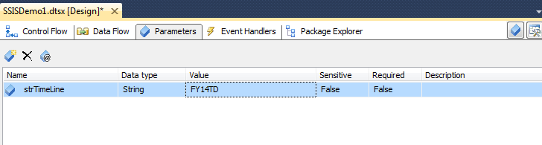
SSIS 2012
Creating a Project – PACKAGE Parameter
Create a new Parameter. You can make it required.

Slide 27

SSIS 2012

Slide 28
SSIS 2012
Deploying a project overview
Loads the entire project, i.e. all packages with current settings to the SSISDB in the Integration Services Catalogs.
Can be exported from the catalog as needed and restored to a Data Tools project.
Packages can be configured in the catalog and executed from the catalog.
SSISDB is a central repository for SSIS packages on a given SQL Server instance.

Slide 29
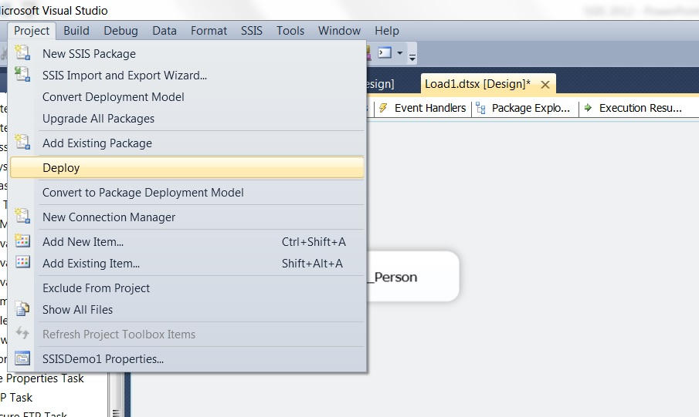
SSIS 2012
Deploying a project – Step 1
Click on Project and then Deploy.

Slide 30
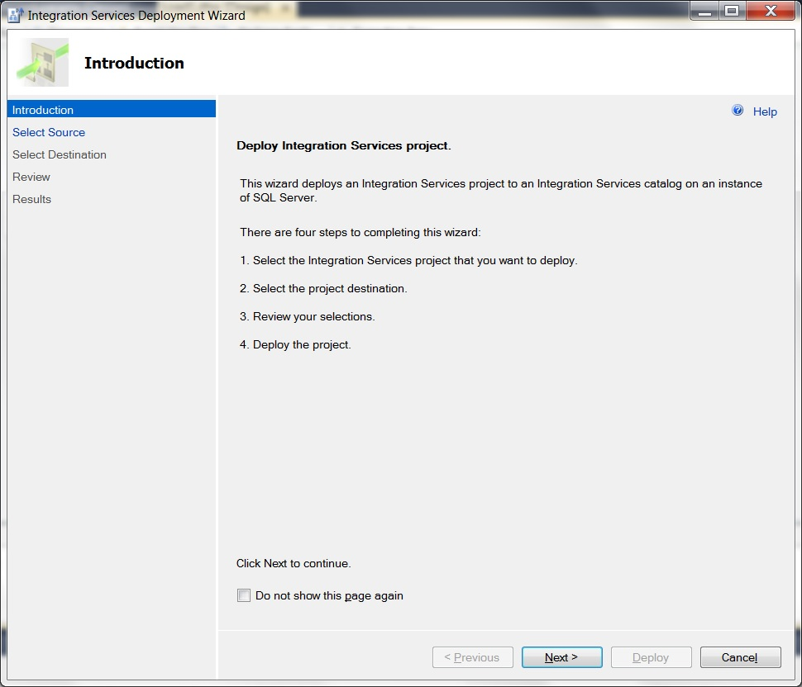
SSIS 2012
Deploying a project – step 2
The Deployment Steps screen. Click Next.

Slide 31
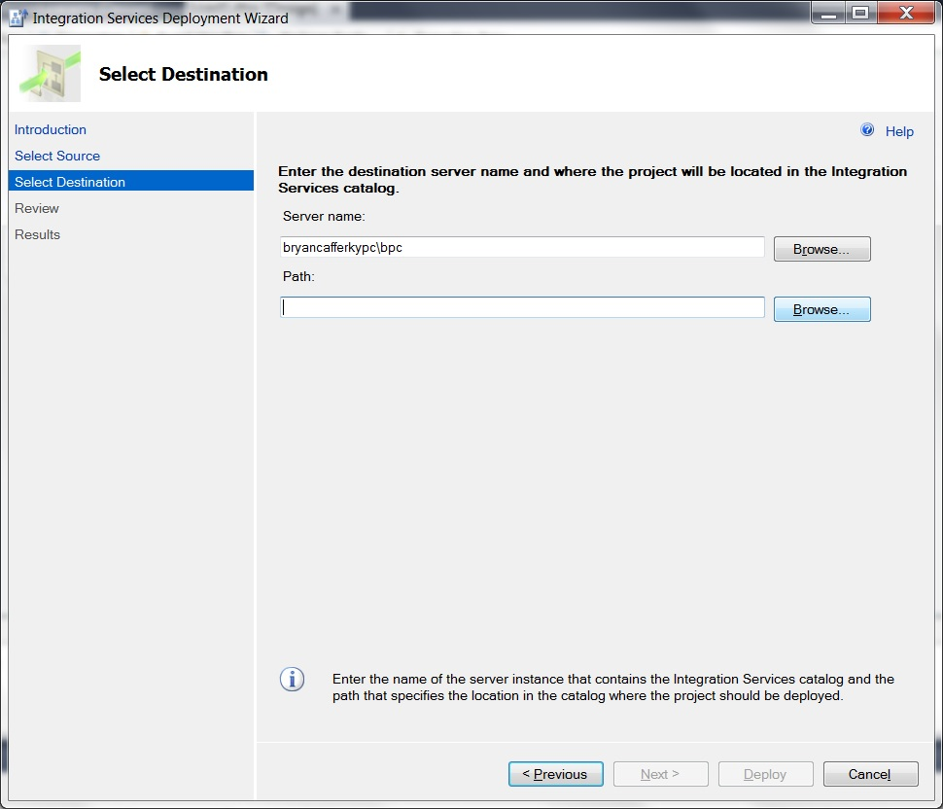
SSIS 2012
Deploying a project – step 3
Enter the SQL Server Instance where the project should be deployed. Click Browse to locate the folder.

Slide 32
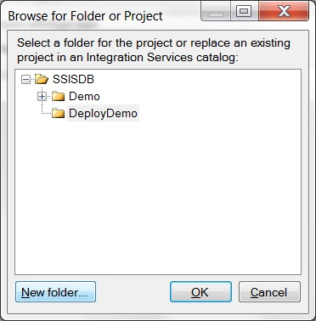
SSIS 2012
Deploying a project – step 4
Select the folder or click on New Folder to create a one.

Slide 33
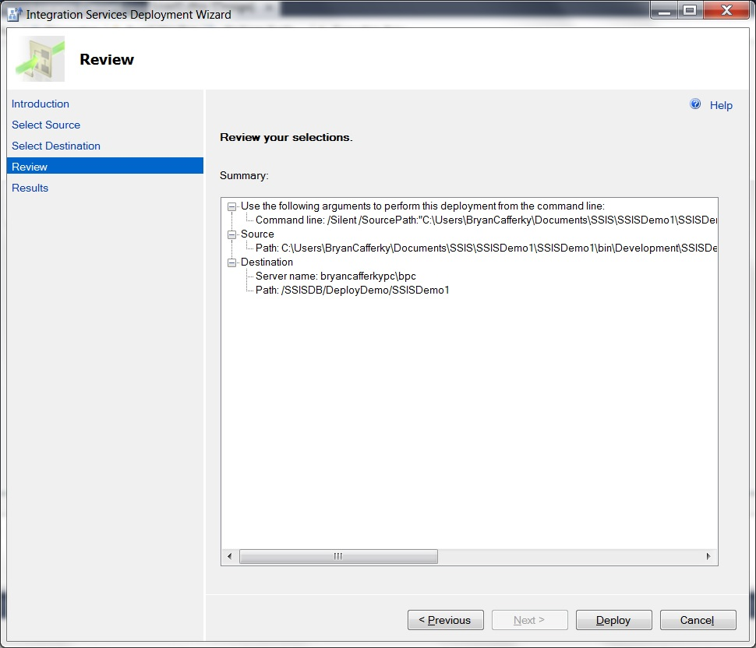
SSIS 2012
Deploying a project – step 5
Verify the settings and click Deploy.

Slide 34
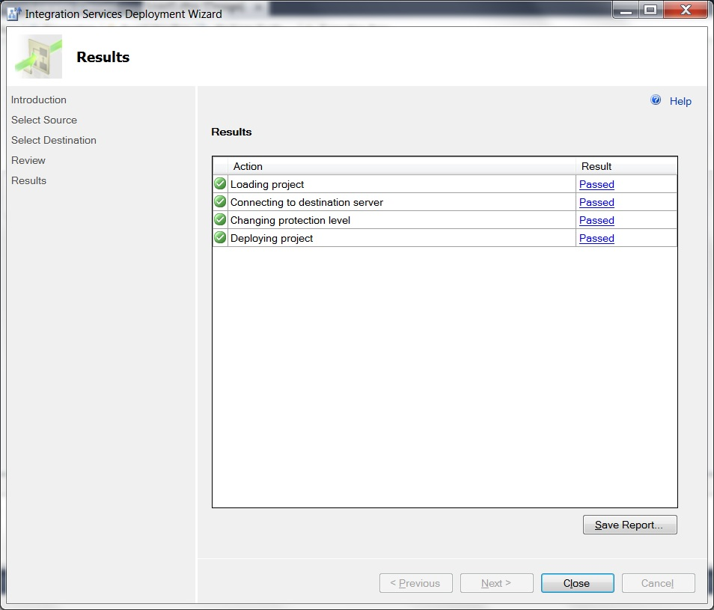
SSIS 2012
Deploying a project – step 6
The deployment confirmation screen shows all tasks Passed. Click Close when ready.

Slide 35

SSIS 2012

Slide 36
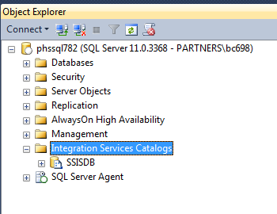
SSIS 2012
New in 2012 – The Integration Services Catalog
Exposes Projects, Packages and Configurationns.

Slide 37
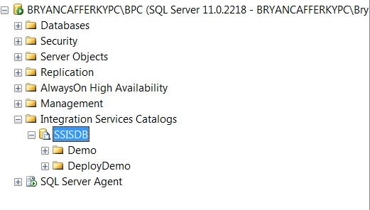
SSIS 2012
New in 2012 – The Integration Services Catalog
Folders hold Projects and Environments.

Slide 38
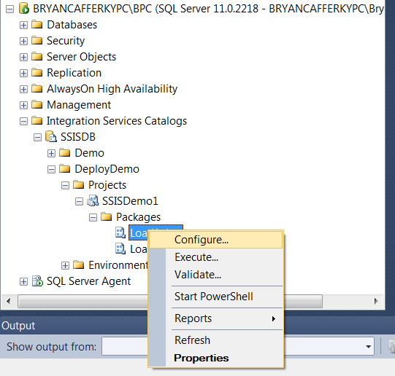
SSIS 2012
New in 2012 – The Integration Services Catalog
Right Mouse Click on a Package or Project to get a Context Sensitive Menu. Select Configure.

Slide 39
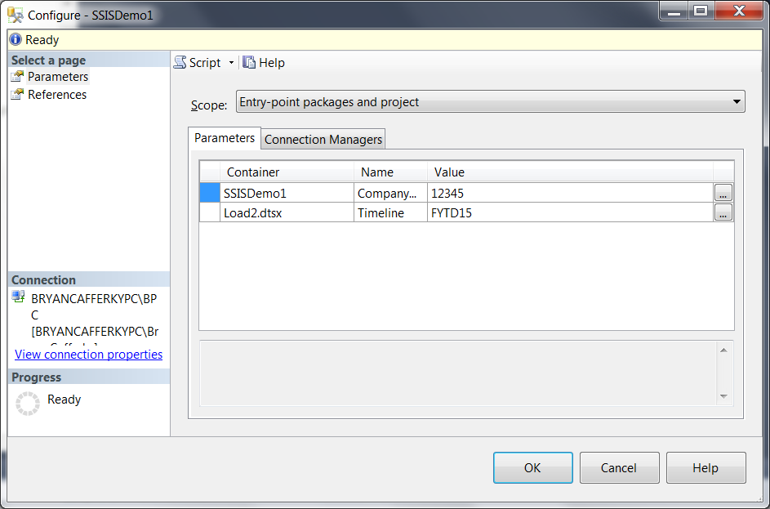
SSIS 2012
New in 2012 – The Integration Services Catalog - Configuration
Enter values for Project Parameters and Connection Managers.

Slide 40
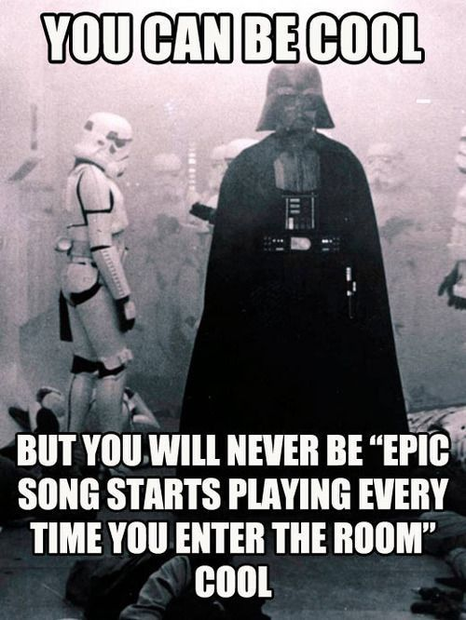

Slide 41
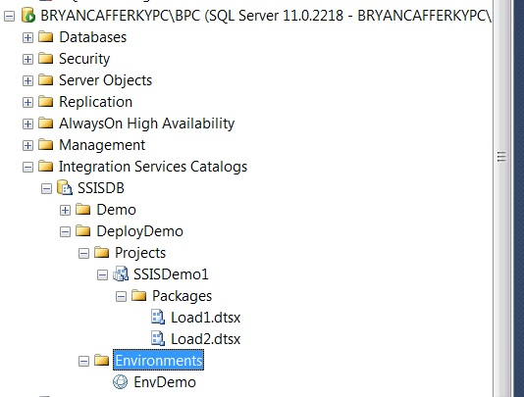
SSIS 2012
New in 2012 – The Integration Services Catalog - Environments
SSIS Environment.
An Environment is just a set of Project Configuration Values stored
as an object in the catalog. The idea is that for each environment, Dev,
Integration, QA and Production, the configuration values will need to be
Different. SSIS Environments make this easier to manage.

Slide 42
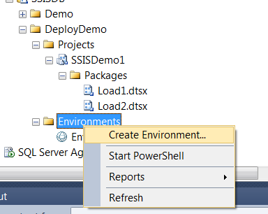
SSIS 2012
New in 2012 – The Integration Services Catalog - Environments

Slide 43
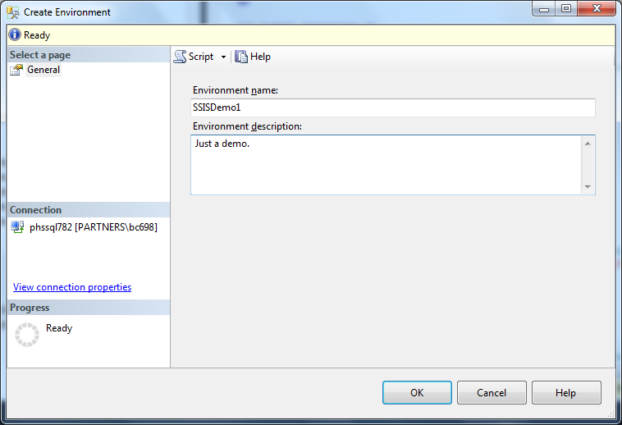
SSIS 2012
New in 2012 – The Integration Services Catalog - Environments
Enter a named and description and click Ok.

Slide 44
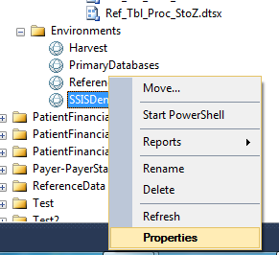
SSIS 2012
New in 2012 – The Integration Services Catalog - Environments
Right Mouse Click and select Properties to edit.

Slide 45
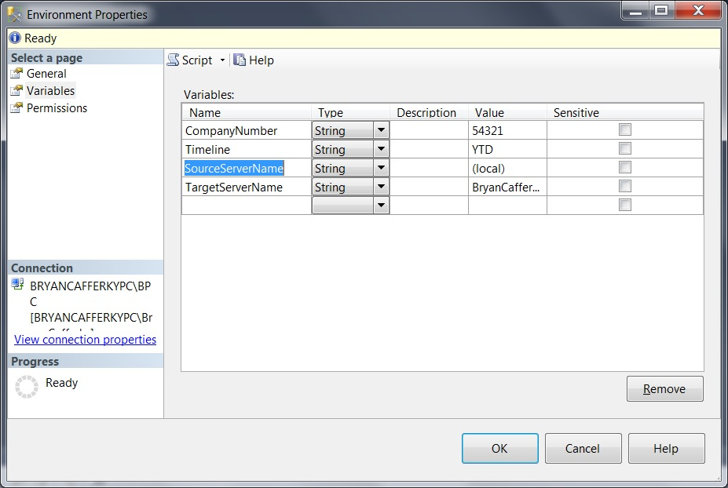
SSIS 2012
New in 2012 – The Integration Services Catalog - Environments
Enter variable names and values. These will be assigned to configuration properties.

Slide 46
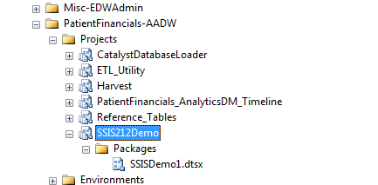
SSIS 2012
New in 2012 – Configuration
You can see the project in the catalog.

Slide 47
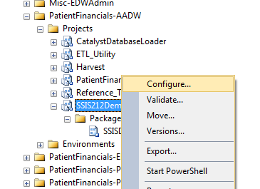
SSIS 2012
New in 2012 – Configuration
Right mouse click on the Project and select Configure.

Slide 48
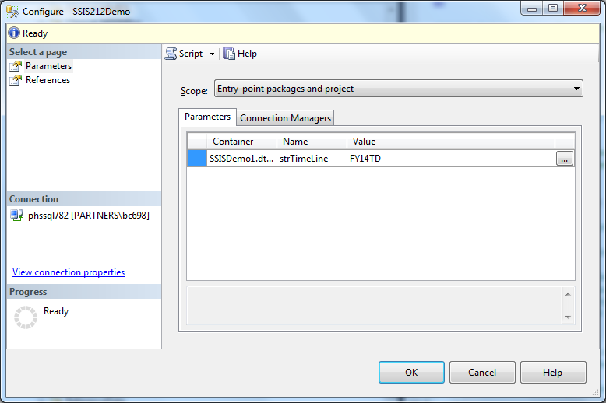
SSIS 2012
New in 2012 – Configuration
Click on the refrences to configure.

Slide 49
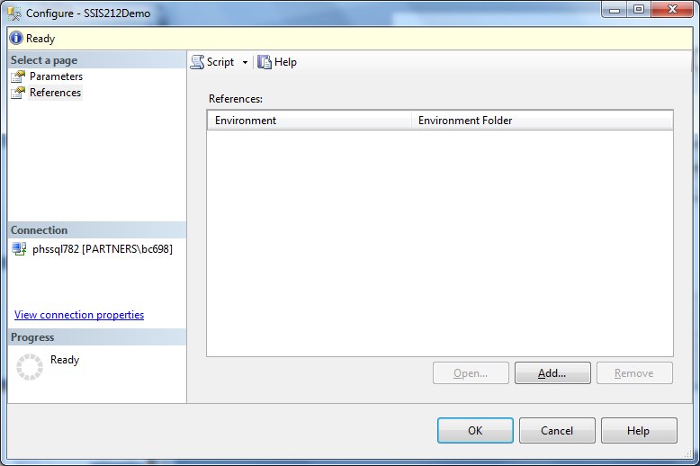
SSIS 2012
New in 2012 – Configuration
Click on Add to add a reference to an Environment.

Slide 50
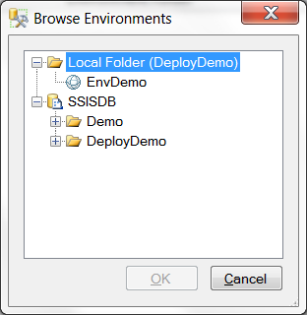
SSIS 2012
New in 2012 – Configuration
Click on the environment and Ok.

Slide 51
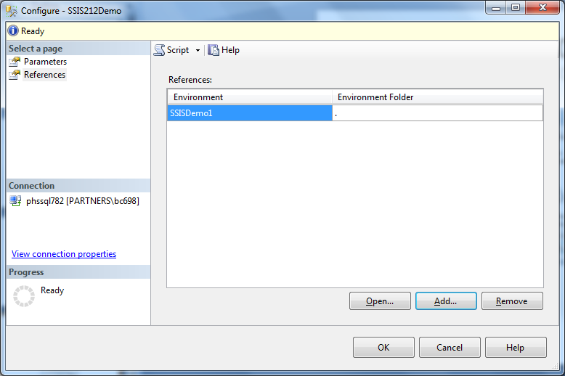
SSIS 2012
New in 2012 – Configuration
You can see the reference was added..

Slide 52
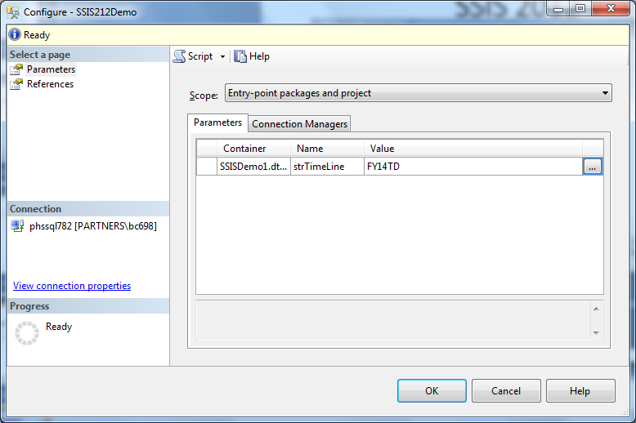
SSIS 2012
New in 2012 – Configuration
Click on Parameters and then the ellipsis.

Slide 53
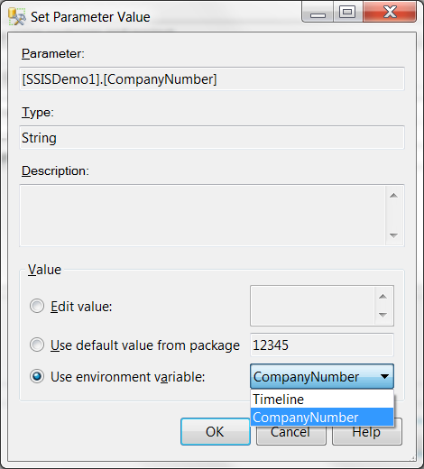
SSIS 2012
New in 2012 – Configuration
Check Use Environment variable and select a variable.

Slide 54
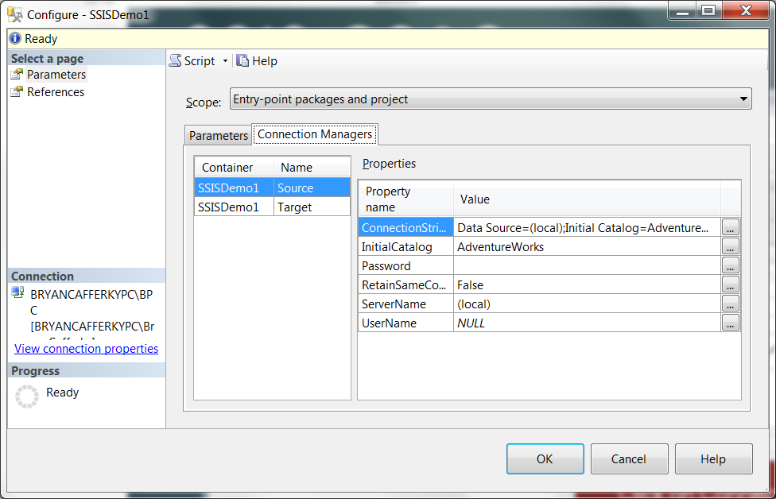
SSIS 2012
New in 2012 – Configuration
Click on Connection Managers and the ellipsis next to ServerName.

Slide 55
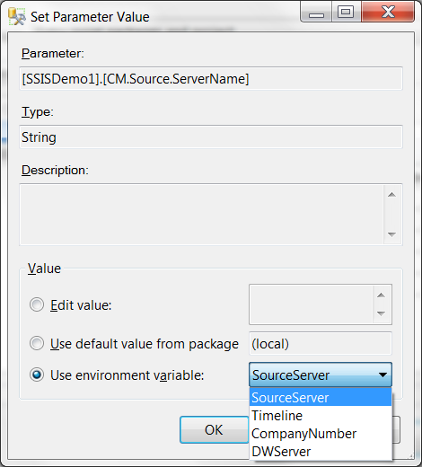
SSIS 2012
New in 2012 – Configuration
Check ‘Use environment variable’ and select the variable from the drop down..

Slide 56
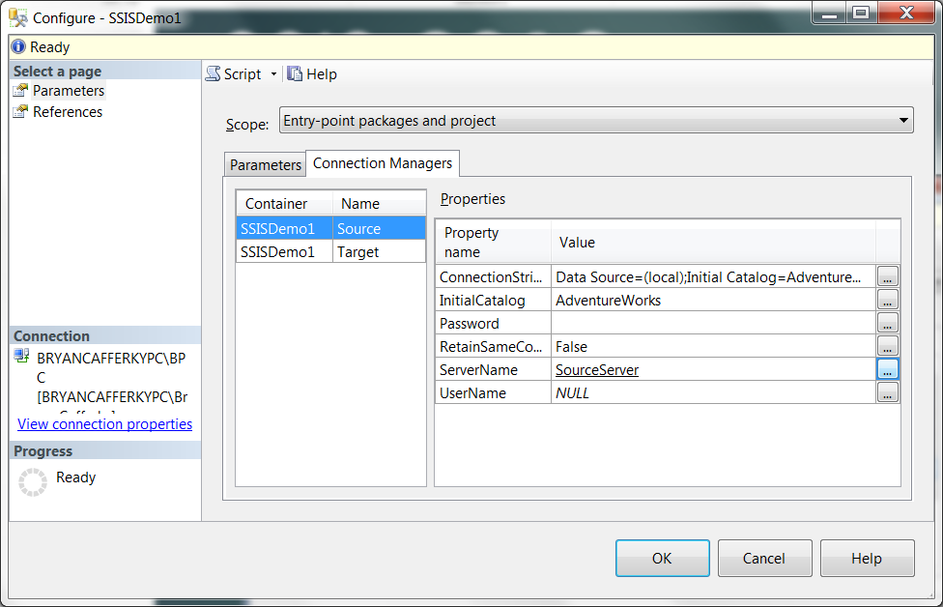
SSIS 2012
New in 2012 – Configuration
Notice ServerName is now set to the environment variable name.

Slide 57
SSIS 2012
New in 2012 – Configuration
QA
Development
Production
SSIS Catalog
Project Folder
SSISProject1
SSISEnv1
Server=devserver
SSIS Catalog
SSISDemo Folder
SSISProject1
SSISEnv1
Server=qaserver
SSIS Catalog
SSISDemo Folder
SSISProject1
SSISEnv1
Server=prodserver
You can deploy the project to each server and it automatically picks up the
configuration settings for that server. Note: We are using relative references.

Slide 58


Slide 59
SSIS 2012
Using SSIS with SQL Agent

Slide 60
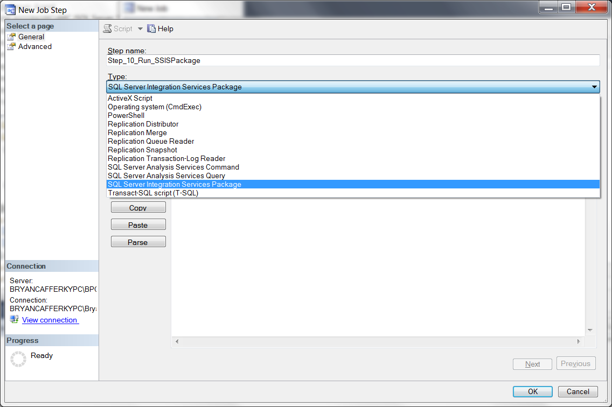
SSIS 2012
Using SSIS with SQL Agent

Slide 61
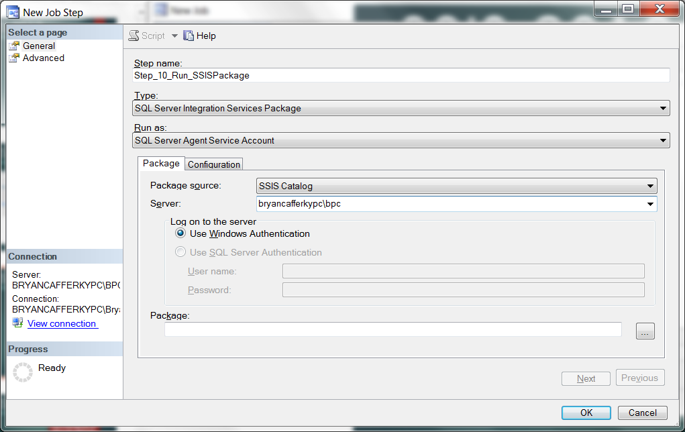
SSIS 2012
Using SSIS with SQL Agent
After entering the server name, click the ellipsis next to the Package text box.

Slide 62
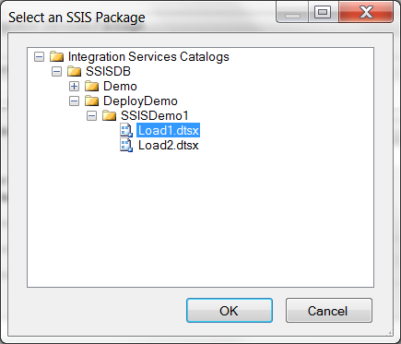
SSIS 2012
Using SSIS with SQL Agent

Slide 63
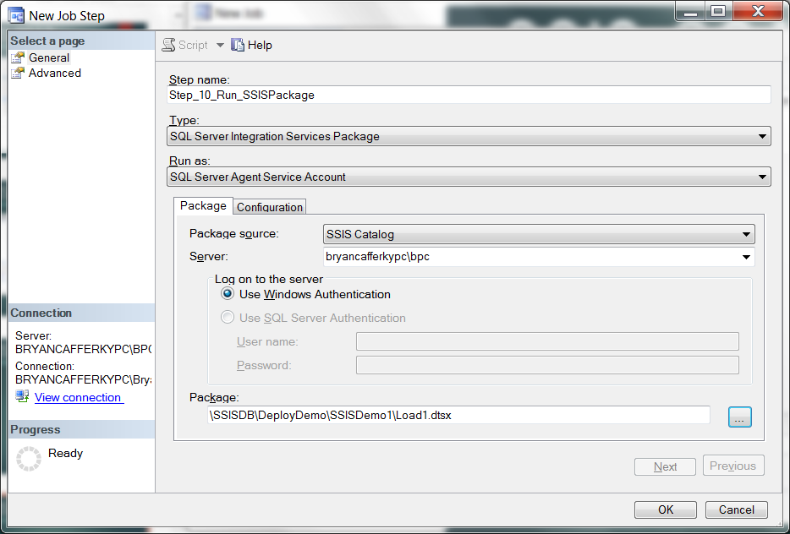
SSIS 2012
Using SSIS with SQL Agent

Slide 64
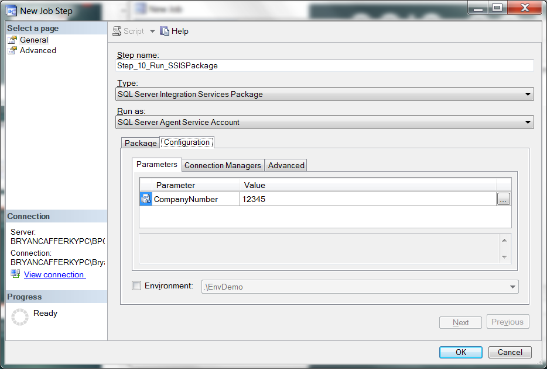
SSIS 2012
Using SSIS with SQL Agent

Slide 65
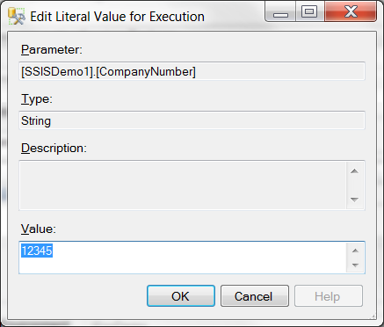
SSIS 2012
Using SSIS with SQL Agent

Slide 66

SSIS 2012
Using SSIS with SQL Agent

Slide 67
SSIS 2012
Using SSIS with SQL Agent
Can use package/project defaults.
Can use Environment variables.
Can be overridden with hard coded values.

Slide 68

SSIS 2012
Using SSIS with SQL Agent

Slide 69

SSIS 2012
Using SSIS with SQL Agent

Slide 70


Slide 71
SSIS 2012
Built-in SSRS Reports

Slide 72

SSIS 2012
New in 2012 – SSRS Reports
When a package fails, you need to view Reports from the catalog to get details.

Slide 73

SSIS 2012
New in 2012 – SSRS reports
Click on All Messages for error details.

Slide 74


Slide 75
SSIS 2012+
What is the Quiet Revolution?
New Architecture Addresses Many SSIS Limitations!
New SSIS Catalog in SQL Server managed via SSMS.
Built-in SSRS Reports on package executions.
Project Deployment Model: All the packages in the project are deployed together.
Configurable Project and Package parameters.
Environments – containers of configurations settings.
True database service execution.

Slide 76
SSIS 2012+
Q & A

